Slide 1

CMS Pixel Mechanical FPIX Half Disk Design Updates
C. M. Lei
Joe Howell
Kirk Arndt
Simon Kwan
November 8, 2011

Slide 2
FPIX Half Disk Layout Requirements
Fits within Phase 1 FPIX envelope definition
Only 2x8 modules are used all oriented radially (resolution slightly improves compared to the layout of the current detector)
Locates all outer radius sensors as far forward and out in radius as possible (to minimize the gap in 4-hit coverage between the end of the 4th-barrel layer and the forward-most disk)
Maximize 4-hit coverage between end of 4th layer barrel up to eta = 2.5, for particles originating at the IP +/-5cm, using a minimum number of modules
Keep the same 20 degree tilt as the current detector
Individual modules to be removable and replaceable without disassembling other modules on the disks
Identical substrates
Minimizes the amount of material required for CO2 cooling and module support
Delta T < 5ºC across a single module and < 14ºC from coolant to sensor
Separate inner and outer ring assemblies for easier replacement of modules on the inner ring
2
Notes:
2

Slide 3
FPix Phase 1 Upgrade Plans
Baseline: 3 half-disks in each half-cylinder
Use only ONE kind of module 2x8, and ONE identical blade.
All modules are arranged radially and placed between r=45mm to 161mm (total 56 modules per half disk or 896 ROCs)
Modules divided into an outer ring of 34 modules and inner ring of 22 modules
Keep the same 20º rotation but for the inner assembly, add a 12º tilt to the IP (inverted cone geometry)
C0₂ cooling:
Use thin-walled SS tubing 316 L and the size is tentatively chosen (1.638 mm OD, 1.435 mm ID).
Use ultra light weight materials for mechanical support and cooling (aim at material reduction of about a factor of 2)
3
Notes:
3

Slide 4
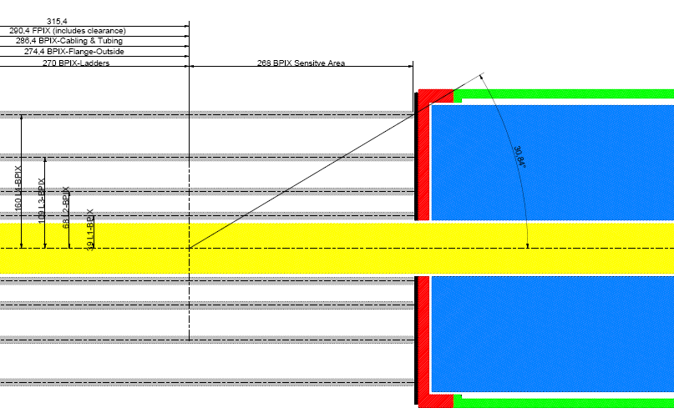
396
Z loc. TBD shown 491mm from IP
291
η = 1.3
η = 1.6
η = 2.1
161
η = 2.5
45
2x8s
2x8s
2x8s
2x8s
2x8s
2x8s
Based on Morris Swartz’s study, it’s possible to optimize the layout to obtain excellent resolution in both the azimuthal and radial directions throughout the FPix acceptance angle since we have separate inner and outer blade assemblies.
Inverted cone array combined with the 20º Rotated Vanes for the inner blade.
4
Notes:
4

Slide 5
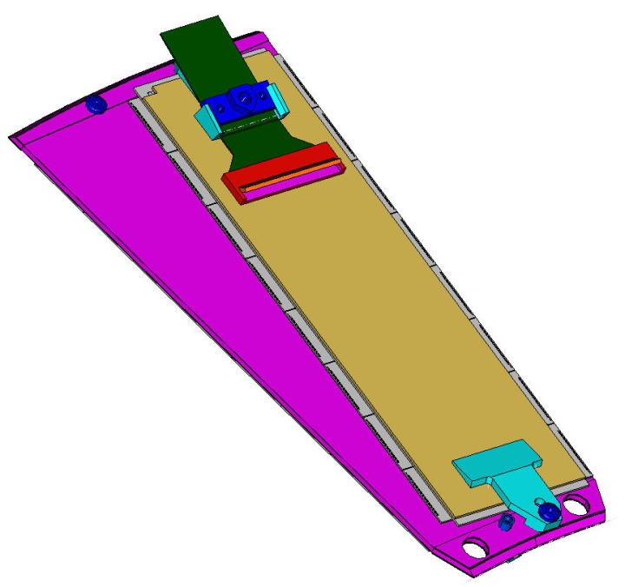
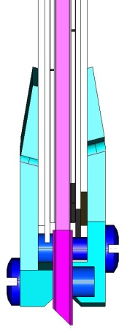
Basic Design of the Pixel Blade
Threaded insert
Solid TPG (0.68 mm thick, highly thermally conductive with in-plane k = 1500 W/mK) encapsulated with carbon-fiber facing (0.06 mm thick).
Extra layer of carbon-fiber at blade ends with 45º cut.
Cooling is arranged at the ends of the blade which is structurally and thermally bonded to cooling rings.
All blades are identical with one module on each side. (Only 2x8 module is used.)
Modules, which are glued with holders at ends, are removable.
Aluminum threaded inserts are glued on blade for module mounting.
One module holder provides cable strain-relief for the flex cable.
Removable module assembly
Through holes to access screws of neighboring blades

Slide 6
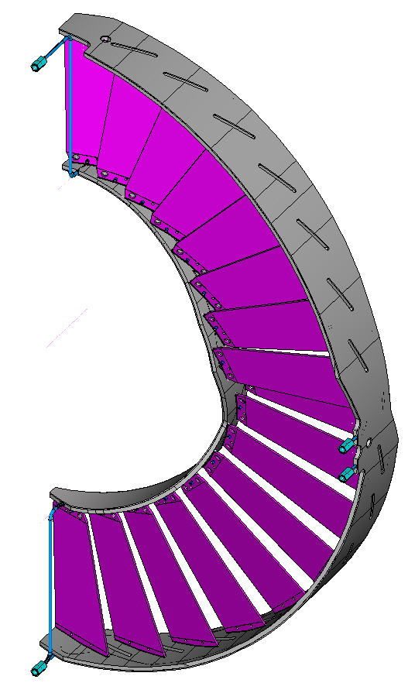
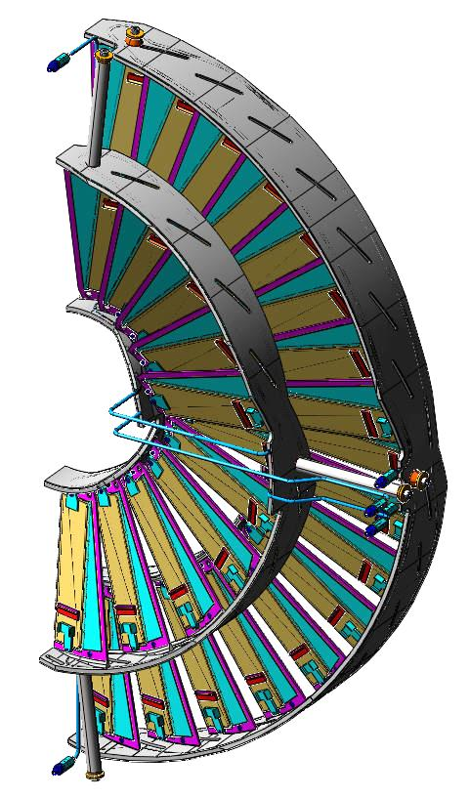
Basic Design of the Half Disk
Half disk consists of one inner and one outer blade assembly.
Both assemblies are fastened to the half cylinder individually with 3 mounts.
Outer blade assembly consists of 17 blades.
Inner blade assembly, with an inverted cone layout, consists of 11 blades.
All blades are bonded to 2 half rings that act as heat sinks.
Each bonded assembly can be mechanically/thermally tested as a unit prior to mounting modules.
Bonded Outer Ring Assembly
ready to take modules

Slide 7
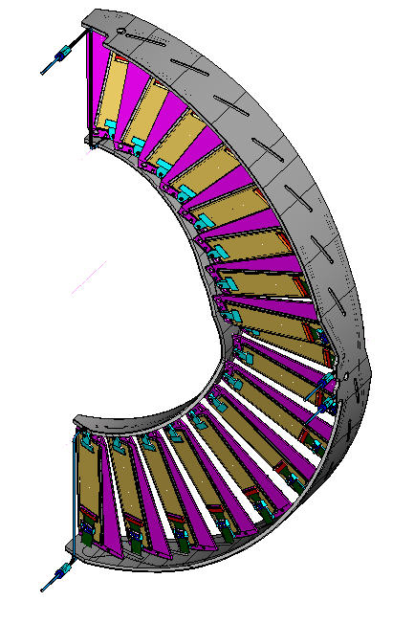
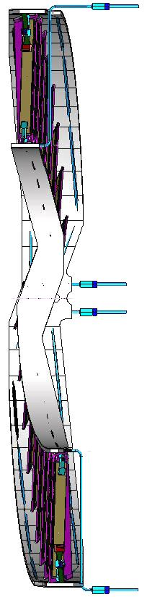
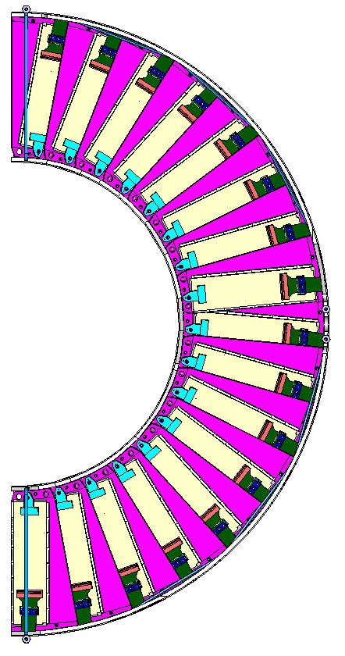
Outer Blade Assembly
17 blades with Y-rotation 20º and Z offset = 2.5 mm, arranged in 2 rows
Closest distance between neighboring blades ~5.5 mm

Slide 8
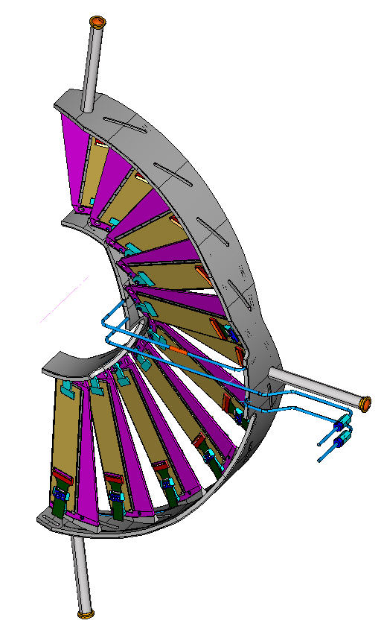
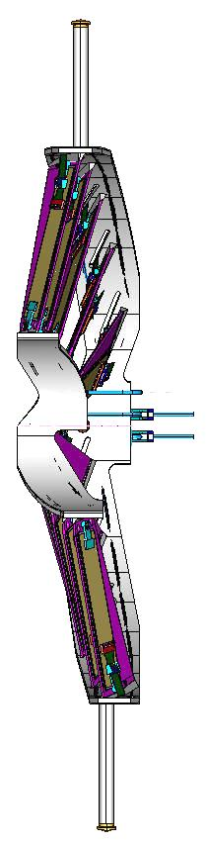
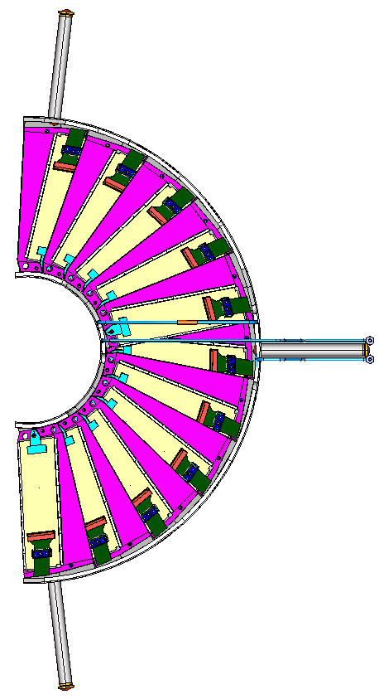
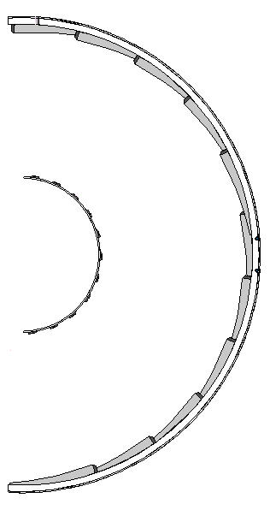
Inner Blade Assembly
11 blades with Y-rotation 20º, X-tilt 12º and Z offset = 4.5 mm, arranged in 2 rows
Closest distance between neighboring blades =~5 mm
Inverted cone layout
Inner ring supporting spokes
Elevated tabs for blade gluing

Slide 9
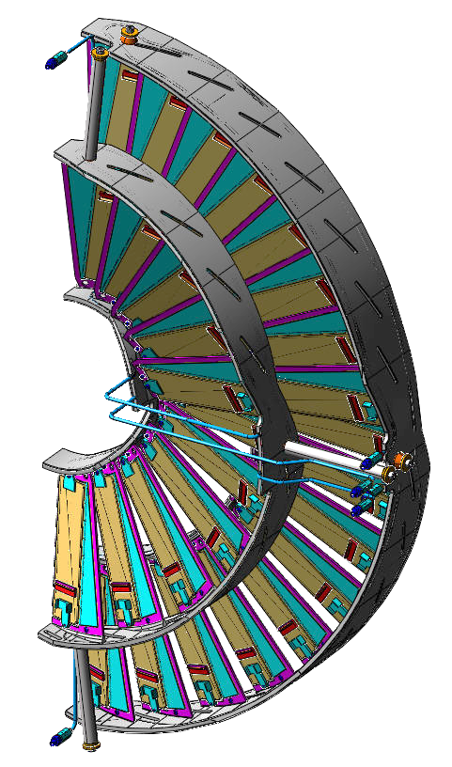
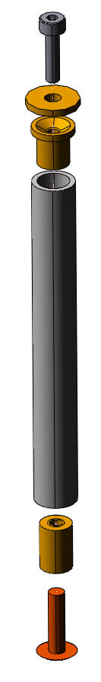
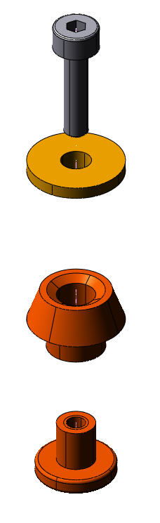
Outer and Inner Mount Assemblies Designs
spherical washer concept employed
a proven design for minor angular misalignment
reinforcement inserts are glued to CC ring for stronger support
assemblies can be removed separately
Outer Assembly Mounts X3
Inner Assembly Mounts X3
M2 screw
Washer with spherical surface
M2 screw
Insert with conical surface
Washer with spherical surface
Insert with conical surface
Cf tubing
Insert with M2 threads
Insert with #3-48 threads
Rivet with #3-48 threads
SS Tubing Coupling X6
Outer Ring Mount Assembly
Inner Ring Mount Assembly

Slide 10
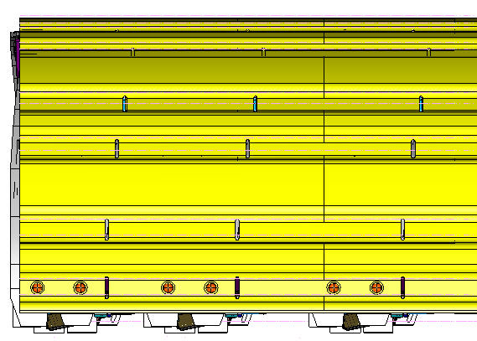
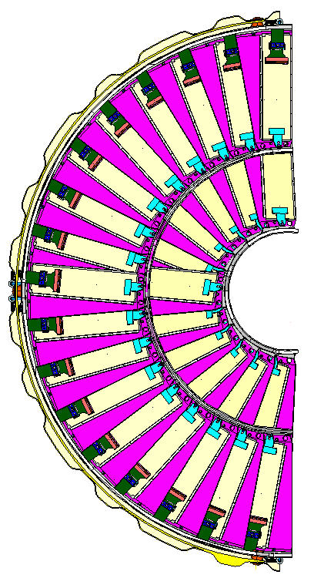
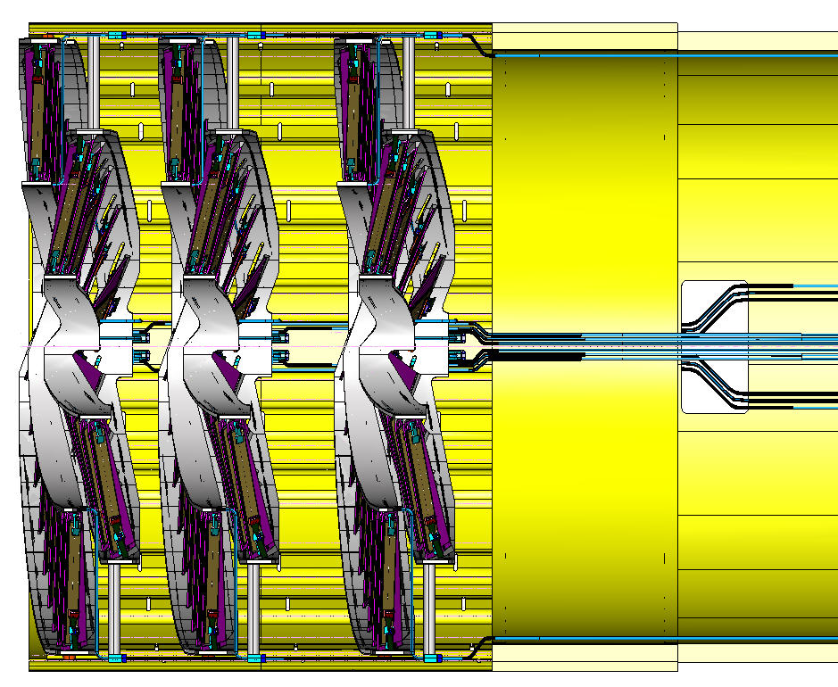
Half Disks within Half Cylinder
Inner Assembly Mount
Outer Assembly Mount

Slide 11
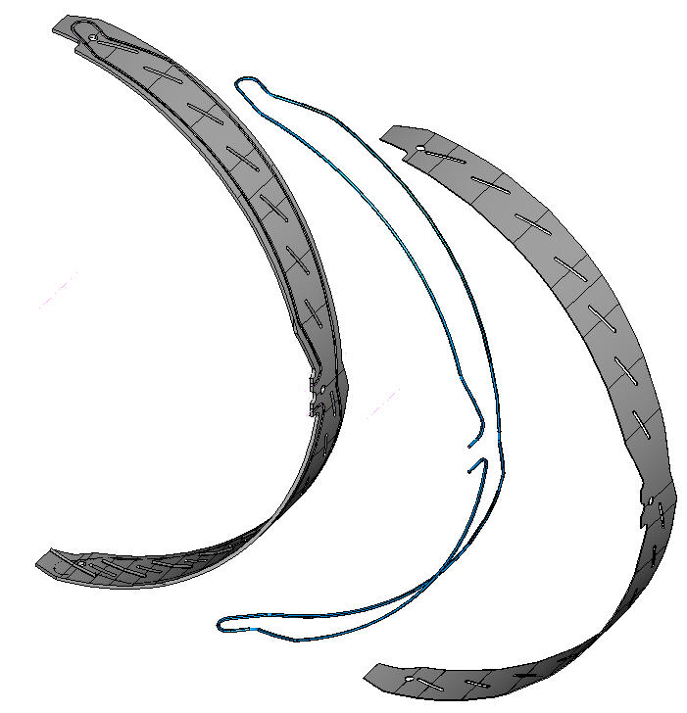
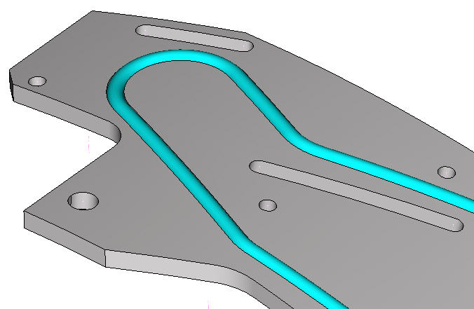
Simple Cooling Arrangement
A simple C-C heat sink in a half ring shape is feasible (thermal k of C-C = ~ 200W/m-K)
A simple and easy-to-fabricate ss tubing is embedded
Structural CF facing is glued to cover the tubing/cooling channel
All the curved-end surfaces of TPG blades are bonded to the surface of CC rings
2 mm X 20 mm cable slot
cf facing
C-C ring
1.634 mm OD
ss tubing

Slide 12
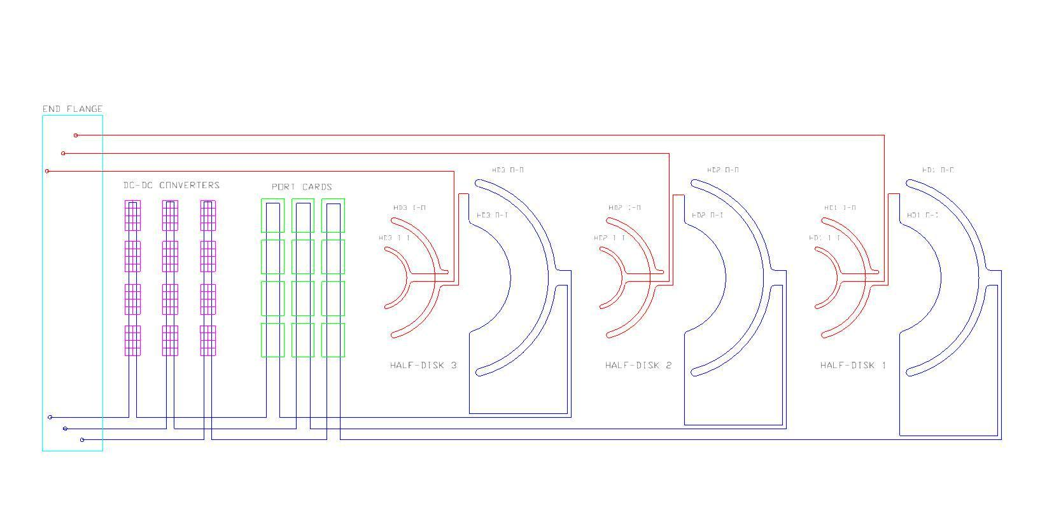
Cooling Tubing Layout … (Lately Proposed)
diagram of 3 (nearly identical) cooling loops in a half-cylinder
→ segmentation of cooling follows segmentation of electronics
1 loop per half-disk = 6 loops per full cylinder
Next steps:
Revise routing within the CC rings and half disk as needed
Calculate the fluid temperature and pressure drop for each of the cooling loops within a half cylinder
Decide how to merge 6 (inlet and outlet) HC loops into 4 inlet and 4 outlet copper tubes to/from the plant

Slide 13
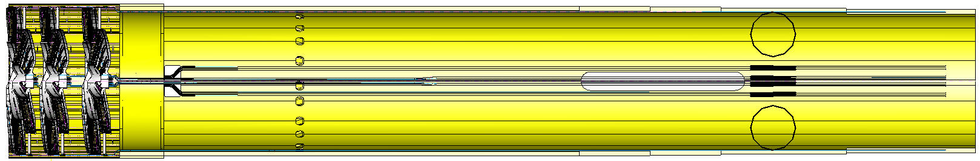
Cooling Tubing Layout … (Lately Proposed - continued)
The 3 cooling tube supply lines need to be routed in this section to make thermal connections to POH on the port cards
DC-DC Converters
Port Cards
The 3 cooling tube supply lines need to be routed in a serpentine path in this section to cool the DC-DC converters

Slide 14
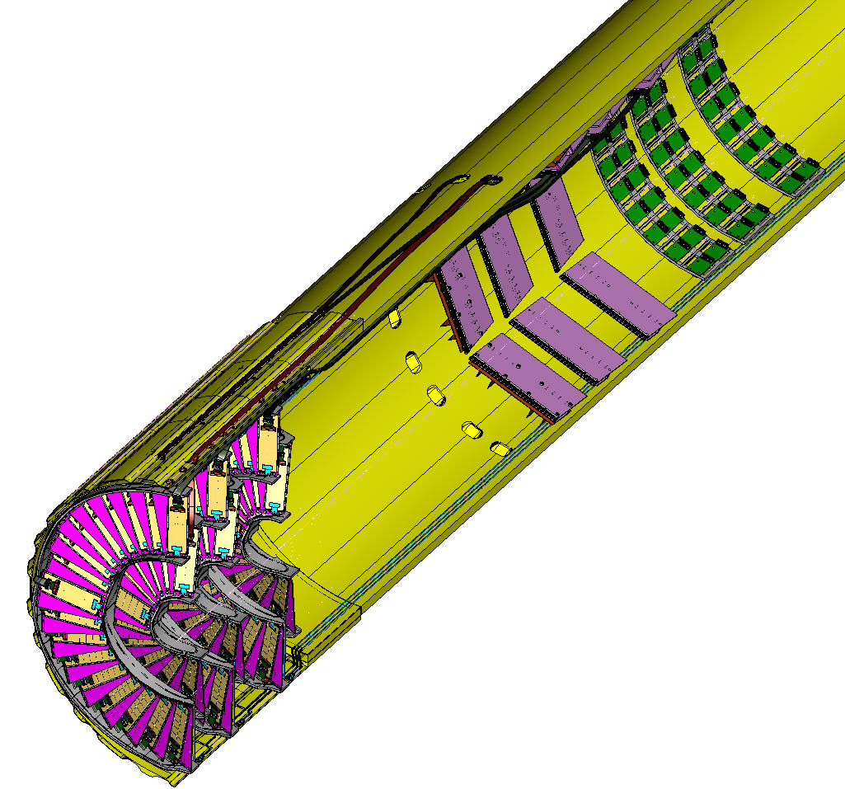
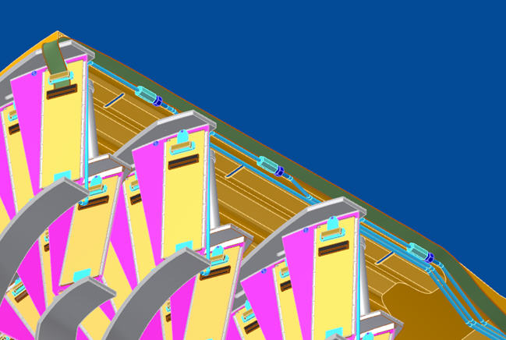
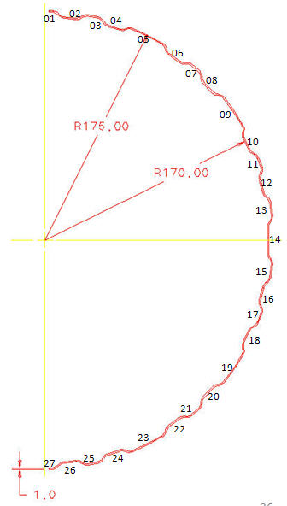
Cooling tube and flex cable routing are allowed installation/removal of the
inner assemblies possible between previously installed outer assemblies
Half Disks with its cooling tubes and cables are installed in the order of
1st, 2nd and 3rd for outer assemblies first
then 3rd, 2nd, 1st for the inner assemblies
Trough # | 1 | 2 | 3 | 4 | 5 |  | 6 | 7 | 8 | 9 |  | 10 | 11 | 12 | 13 | 14 | 15 | 16 | 17 | 18 | 19 |  | 20 | 21 | 22 | 23 |  | 24 | 25 | 26 | 27 | total
Outer Inner Tubing | 3 |  |  |  |  |  |  |  |  |  |  |  |  |  |  |  |  |  |  |  |  |  |  |  |  |  |  |  |  |  | 3 | 6
Outer Outer Tubing |  |  |  |  |  |  |  |  |  |  |  |  |  |  |  | 6* |  |  |  |  |  |  |  |  |  |  |  |  |  |  |  | 6
Inner Tubing |  |  |  |  |  |  |  |  |  |  |  |  |  |  |  | 6 |  |  |  |  |  |  |  |  |  |  |  |  |  |  |  | 6
Outer Cable | 1 |  | 2 |  | 2 | 2 |  | 2 |  | 2 | 2 |  | 2 |  | 2 |  | 2 |  | 2 |  | 2 | 2 |  | 2 |  | 2 | 2 |  | 2 |  | 1 | 34
Inner Cable |  | 1 |  | 2 |  |  | 2 |  | 2 |  |  | 2 |  | 2 |  |  |  | 2 |  | 2 |  |  | 2 |  | 2 |  |  | 2 |  | 1 |  | 22
* Tubing located inside HC beyond the trough

Slide 15
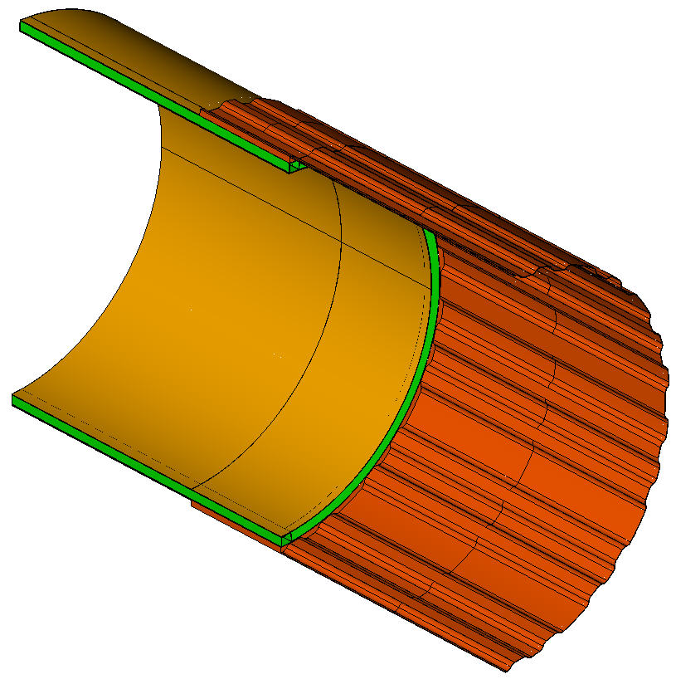
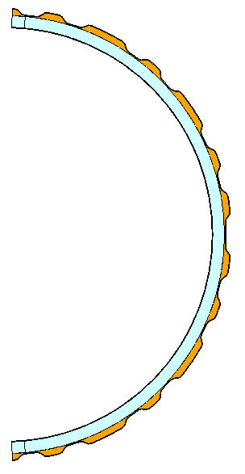
Conceptual Design of Half Cylinder
Thin, front section with 27 troughs → cooling tubes and cables of the inner assemblies can be removed
from the outside of the HC, while outer assembly tubes and cables are kept inside the HC
All carbon-fiber reinforced plastic design consisting of 3 sections:
- front corrugated single-wall section (1 mm thick)
- transition section where front and rear sections are glued together
- rear section (which is basically the same as the existing design)
Filled with cf in transition section
- enhance stiffness
- increase surface area for gluing
rear section (shorten)
transition section
front section
Note: only a short length of rear section is shown

Slide 16
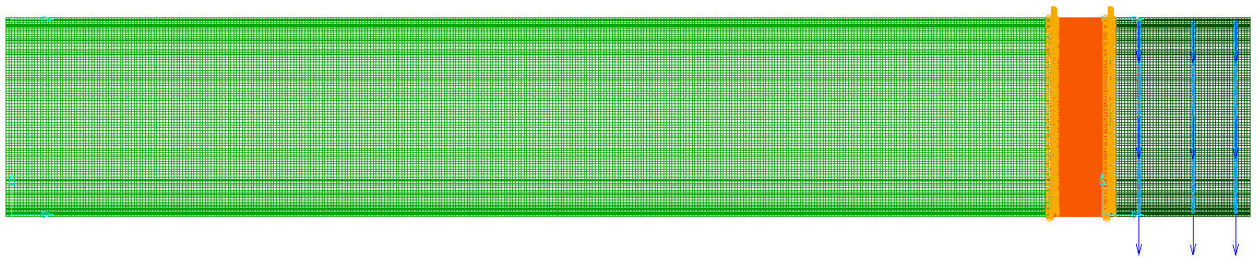
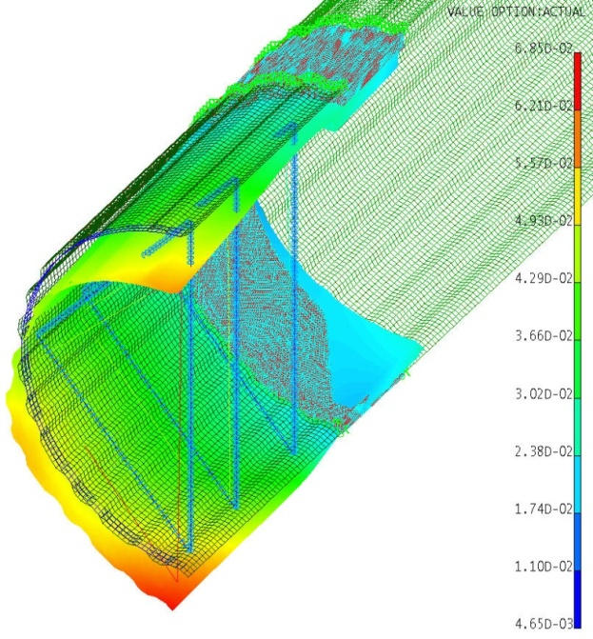
Preliminary FEA of Half Cylinder
FEA as an aid for designing the front and transition regions (results for the rear section suppressed)
Used shell elements to model the trough profile through all length, except the transition region with solid elements.
Applied constraints on 4 support leg positions, with 2 top supports allowing downward displacement.
Half disk loads of 3.9 N each applied at 3 spots, no distributed load along the rear section.
3 beam “spokes” simulate half disks that help to retain a circular profile
Rear End Support
Front End Support
Max displacements in x, y, z
-0.028, -0.059, -0.020 mm
Note: Rigid elements were used for proper model connectivity between solid and shell elements.

Slide 17
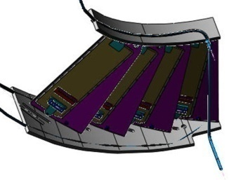
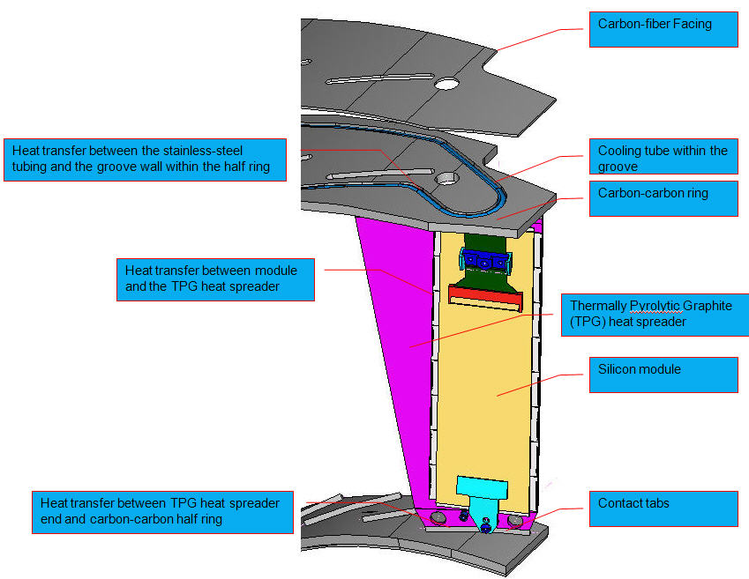
4-Blade Thermal Testing Assembly
Use this test to verify the overall temperature drop experimentally from the CO2 coolant to module (Goal: to be within 10ºC with a heat load of 3W per module, agreed upon at the last CMS Tracker Upgrade Mechanics/Cooling Meeting as the cooling performance specification for the design)
4 TPG blades will be bonded to 2 CC ring segments
Dummy 2x8 modules will be glued to blades

Slide 18

Thermally Interface Materials (TIMs) Needed in this Test
Module on blade >> thermally conductive grease
Blade on CC half ring >> structural and thermally conductive adhesive
SS tubing within CC groove >> thermally conductive fillers/adhesive
CF facing on CC half ring >> structural adhesive
Note: Need to carefully select the TIMs 1, 2 and 3 for the testing. Thermal conductivities of these TIMs are preferred to be > 1 W/mK.
18

Slide 19

TIMs Study and Lab-Testing Results
 |  |  |  |  |  |  |  |  |  |  |  | Tested |  | Tested |  | Claimed |  | Claimed
 |  | thickness |  | bulk density |  | temperature |  | specific heat |  | diffusivity |  | conductivity |  | resistance |  | conductivity |  | resistance
 |  | @ 25°C |  | ρ @ 25°C |  |  |  | c_{p} |  | α |  | λ |  | R |  | λ |  | R
Sample |  | (mm) |  | (g/cm³) |  | (°C) |  | (J/g-K) |  | (mm²/s) |  | (W/m-K) |  | (mm²-K/W) |  | (W/m-K) |  | (mm²-K/W)
EG7659 |  | 0.714 |  | 2.21 |  | 25 |  | 0.731 |  | 0.838 |  | 1.35 |  | - |  | 11.40 |  | -
C-C substrate |  | 1.76 |  | 1.82 |  | 25 |  | 0.733 |  | 238 |  | 319 |  | 5.53 |  | 200 |  | -
CGL7019-LB |  | 0.030 |  | 2.0 |  | 25 |  | 1.0 |  | 0.167 |  | 0.334 |  | 89.8 |  | 20.0 |  | 3.0
TPCM583 |  | 0.070 |  | 2.5 |  | 25 |  | 0.8 |  | 2.04 |  | 4.08 |  | 17.1 |  | 4.00 |  | 1.2
Duralco 135 |  | 0.067 |  | 2.7 |  | 25 |  | 0.8 |  | 0.525 |  | 1.13 |  | 59.0 |  | 5.80 |  | -
Dow TC-5600 |  | 0.093 |  | 2.7 |  | 25 |  | 0.8 |  | 2.91 |  | 6.28 |  | 14.8 |  | 7.10 |  | 4.0

Slide 20
TIMs Selection Status
Module on blade
Laird’s TPCM 583 or Dow Corning’s TC-5600 are OK
Blade on C-C half ring
AiT’s EG7659 is barely OK
Try other adhesives
Try indium bonding
SS tubing within CC groove
Dow Corning’s TC-5600 appears OK

Slide 21
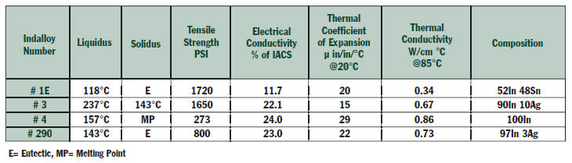
Indium Bonding
An interface metallic material with high thermal conductivity and low melting point
Only works for metal-to-metal surface; noble metal coating(s) like gold, silver, nickel needed for bonding graphite
Other layer(s) to act as a diffusion barrier to achieve strong inter-metallic bonds may be needed.
Oxidization of metal surface interferes with the wetting capability → flux can be used to improve wetting
Several alloys available

Slide 22
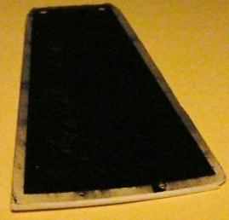
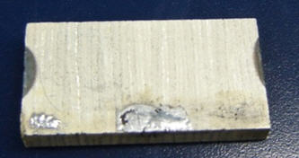
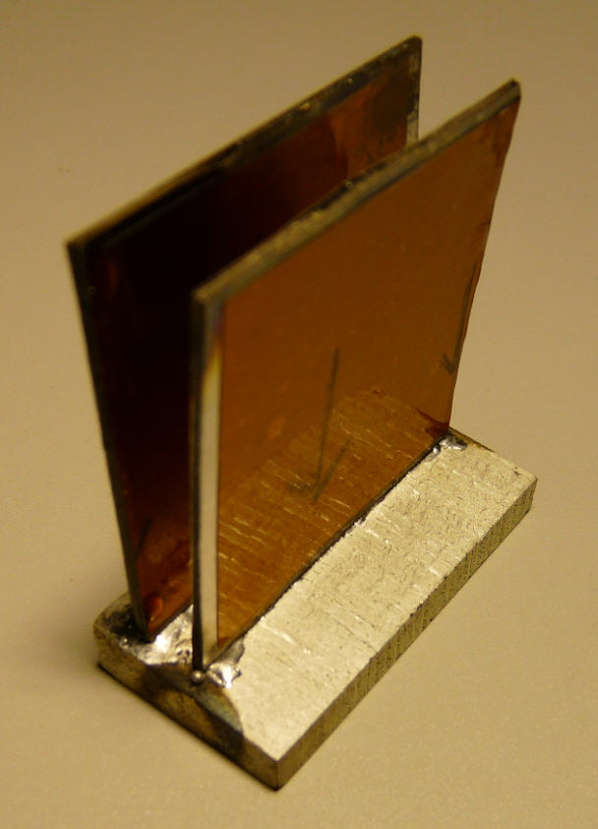
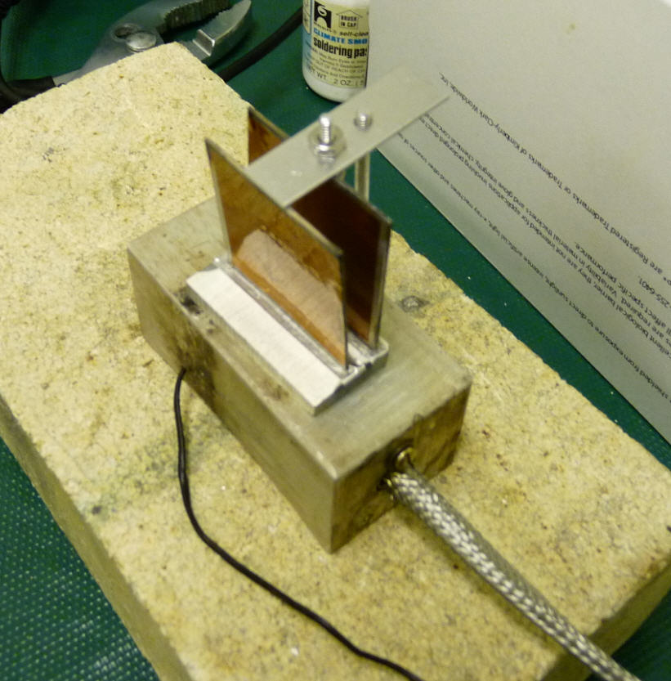
Indium Bonding R&D
Goal: To demonstrate the cut-end of the encapsulated TPG can be bonded to carbon-carbon surface
Indium alloy used: #1E
Thermal k = 34 W/m-K
Tensile strength = 1,720 psi
X0 = 1.22 cm
Status:
carbon-carbon surface
5 micron thick silver were successfully coated
Indium #1E wetted this surface well
TPG cut-end surface which consists of carbon-fiber facing and TPG core
5 micron thick silver was successfully coated
these silvered coated parts could be bonded together
joint was not strong enough
silver layer easily detached from TPG surface
Future R&D
Add diffusion barrier(s)
C + Ni + Ag + In
C+ Ti + W + Ag + In
Indium #1E
Heated Platform

Slide 23
Half Disk Material Budget
Half Disk Material Budget according to conceptual design November 2011 |  |  |  |  | 1832.39 | vol of .8mm t blade with step at ends
All masses are distribued evenly over an effective overlapped substrate area = |  |  |  |  | 5343 | mm^2 |  | (15º coverage) |  | (15º coverage) |  | (15º coverage)
 | material | t or L, mm | area, mm^2 | vol, mm^3 | half disk q'ty | half disk vol, mm^3 | half disk mass, g | 15-deg vol, mm^3 | density, g/cc | Mass, g | X0, g/cm^2 | Eff. % Rad L
ROC | silicon | 0.15 | 80 | 12 | 896 | 10701 | 24.9 | 892 | 2.33 | 2.078 | 21.9 | 0.18%
Sensor | silicon | 0.25 | 1245 | 311 | 56 | 17432 | 40.6 | 1453 | 2.33 | 3.385 | 21.9 | 0.29%
Sub-Total % RL |  |  |  |  |  |  |  |  |  |  |  | 0.47%
TPG | TPG | 0.680 | 2290 | 1557 | 28 | 43602 | 98.5 | 3633 | 2.26 | 8.212 | 42.7 | 0.36%
CF facing | CF | 0.120 | 2290 | 275 | 28 | 7694 | 13.5 | 641 | 1.76 | 1.129 | 42.8 | 0.05%
module end holder set | PEEK |  |  | 169 | 56 | 9482 | 17.1 | 790 | 1.8 | 1.422 | 34.9 | 0.08%
screws | titanium |  |  | 6 | 112 | 624 | 2.8 | 52 | 4.54 | 0.236 | 16.2 | 0.03%
TIM btw ROC & substrate, 80% | silicone | 0.05 | 1394 | 56 | 56 | 3123 | 3.4 | 260 | 1.1 | 0.286 | 25.1 | 0.02%
TIM btw ROC & substrate, 20% | boron nitrile | 0.05 | 1394 | 14 | 56 | 781 | 2.7 | 65 | 3.5 | 0.228 | 43.4 | 0.01%
TIM for gluing the blades to rings, 80% | silicone | 0.05 | 58 | 2 | 28 | 65 | 0.1 | 5 | 1.1 | 0.006 | 25.1 | 0.00%
TIM for gluing the blades to rings, 20% | boron nitrile | 0.05 | 58 | 1 | 28 | 16 | 0.1 | 1 | 3.5 | 0.005 | 43.4 | 0.00%
Sub total % RL for substrate |  |  |  |  |  |  |  |  |  |  |  | 0.54%
HDI, kapton | kapton | 0.1 | 1141 | 114 | 56 | 6392 | 8.9 | 533 | 1.4 | 0.746 | 38.4 | 0.04%
HDI, adhesive | silicone | 0.05 | 1141 | 57 | 56 | 3196 | 4.0 | 266 | 1.25 | 0.333 | 25.1 | 0.02%
HDI, copper, 28% | copper | 0.057 | 1141 | 18 | 56 | 1020 | 9.5 | 85 | 9.3 | 0.791 | 12.9 | 0.12%
Flex cable connector | polyester |  |  | 52 | 56 | 2917 | 4.1 | 243 | 1.4 | 0.340 | 28.7 | 0.02%
Sub total % RL for HDI |  |  |  |  |  |  |  |  |  |  |  | 0.20%
Outer outer tubing | ss 316L | 1114 | 0.49 | 545 | 1 | 545 | 4.3 | 45 | 7.82 | 0.355 | 14.1 | 0.05%
Outer inner tubing | ss 316L | 493 | 0.49 | 241 | 1 | 241 | 1.9 | 20 | 7.82 | 0.157 | 14.1 | 0.02%
Inner outer tubing | ss 316L | 832 | 0.49 | 406 | 1 | 406 | 3.2 | 34 | 7.82 | 0.265 | 14.1 | 0.04%
Inner inner tubing | ss 316L | 501 | 0.49 | 245 | 1 | 245 | 1.9 | 20 | 7.82 | 0.159 | 14.1 | 0.02%
Coolant for 4 tubing | CO2 liq. | 2939 | 1.62 | 2939 | 1 | 2939 | 3.0 | 245 | 1.03 | 0.252 | 36.2 | 0.01%
TIM for filling up the groove, 80% | silicone | 1858 | 0.63 | 931 | 1 | 931 | 1.0 | 78 | 1.1 | 0.085 | 25.1 | 0.01%
TIM for filling up the groove, 20% | boron nitrile | 1858 | 0.63 | 233 | 1 | 233 | 0.8 | 19 | 3.5 | 0.068 | 43.4 | 0.00%
Coupling | ss 304 |  |  | 61 | 6 | 366 | 2.9 | 31 | 7.82 | 0.239 | 14.1 | 0.03%
Coupling | titanium |  |  | 43 | 6 | 260 | 1.2 | 22 | 4.54 | 0.098 | 16.2 | 0.01%
Sub total % RL for tubing and coolant |  |  |  |  |  |  |  |  |  |  |  | 0.19%
Outer outer ring | CC | 2 |  | 30476 | 1 | 30476 | 54.9 | 2540 | 1.80 | 4.571 | 42.7 | 0.20%
Outer outer skin | CF | 0.56 |  | 8377 | 1 | 8377 | 14.7 | 698 | 1.76 | 1.229 | 42.8 | 0.05%
Outer inner ring | CC | 2 |  | 8700 | 1 | 8700 | 15.7 | 725 | 1.80 | 1.305 | 42.7 | 0.06%
Outer inner skin | CF | 0.56 |  | 2308 | 1 | 2308 | 4.1 | 192 | 1.76 | 0.339 | 42.8 | 0.01%
Inner outer ring | CC | 2 |  | 17220 | 1 | 17220 | 31.0 | 1435 | 1.80 | 2.583 | 42.7 | 0.11%
Inner outer skin | CF | 0.56 |  | 4523 | 1 | 4523 | 8.0 | 377 | 1.76 | 0.663 | 42.8 | 0.03%
Inner inner ring | CC | 2 |  | 4985 | 1 | 4985 | 9.0 | 415 | 1.80 | 0.748 | 42.7 | 0.03%
Inner inner skin | CF | 0.56 |  | 1322 | 1 | 1322 | 2.3 | 110 | 1.76 | 0.194 | 42.8 | 0.01%
Inner mount tubing & inserts | G10 |  |  | 973 | 3 | 2918 | 5.1 | 243 | 1.76 | 0.428 | 42.8 | 0.02%
Inner mount screw | aluminum |  |  | 106 | 3 | 318 | 0.9 | 27 | 2.7 | 0.072 | 24.0 | 0.01%
Outer mount insert | G10 |  |  | 224 | 3 | 673 | 1.2 | 56 | 1.76 | 0.099 | 42.8 | 0.00%
Outer mount screw | aluminum |  |  | 46 | 3 | 138 | 0.4 | 12 | 2.7 | 0.031 | 24.0 | 0.00%
Sub total % RL for rings |  |  |  |  |  |  |  |  |  |  |  | 0.54%
Total |  |  |  |  |  |  | 397.6 |  |  | 33.1 |  | 1.94%

Slide 24
Next Steps
Continue indium bonding R&D
Select proper TIMs for 4-blade thermal test
Indium bonding R&D is in critical path
Practice production steps with developed tooling
Glue module holders on module
Glue threaded inserts on TPG blade
Glue TPG blades on C-C rings to form bare half disk
Place and mount modules on TPG blades of bare half disk
Conduct 4-blade thermal test
Design half cylinder
Pressure test of cooling coupling weldment assembly
Run cooling loop flow test with CO2 pilot plant

Slide 25
Backup Slides

Slide 26
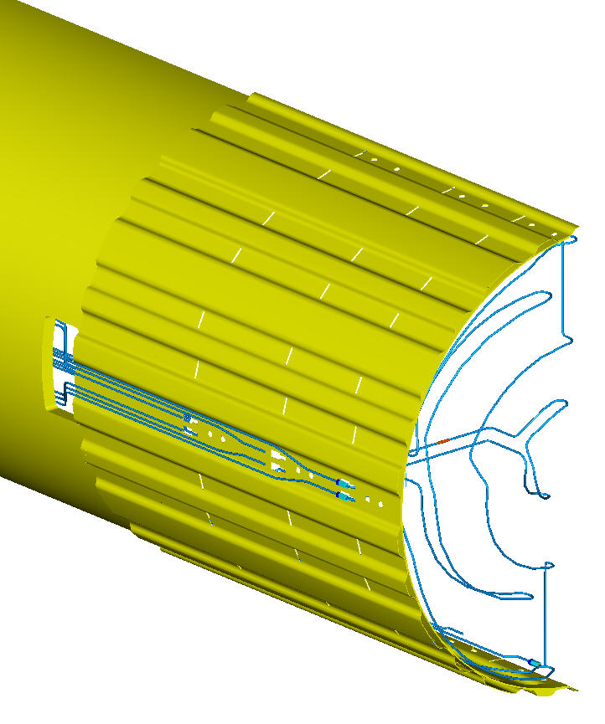
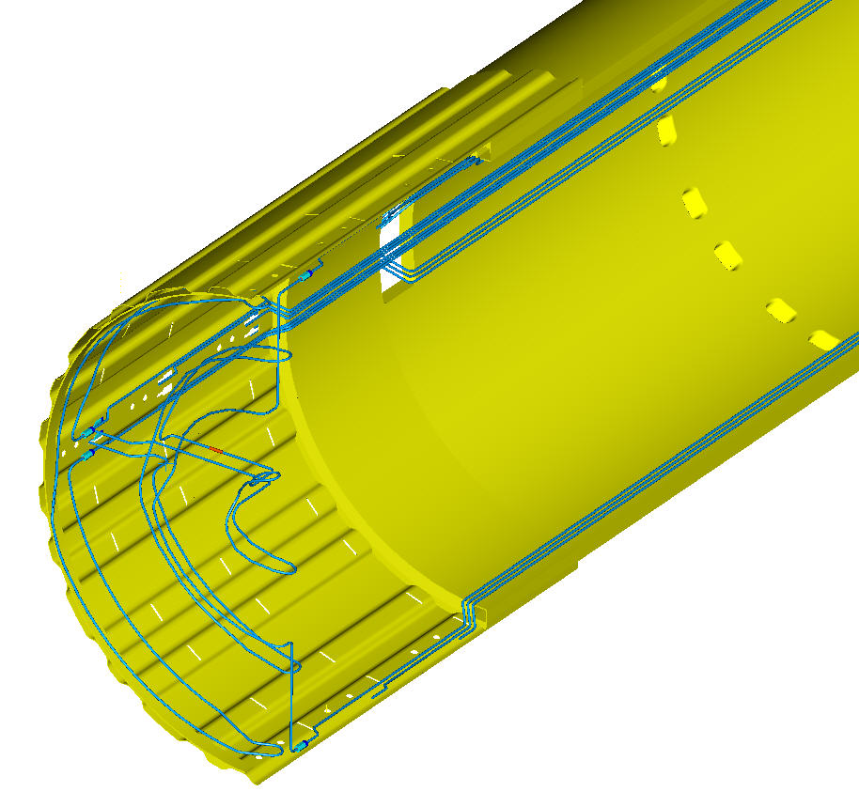
Cooling Tubing Layout……Original
Outer Outer Tubing – 2 outlets from each half disk, located at 3 o’ clock position, inside HC
Outer Inner Tubing – 2 outlets from each half disk, 1at top + 1 at bottom, inside HC
Inner Assembly Tubing – 2 outlets from each half disk, at 3 o’ clock position, outside then inside HC
Inner Assembly Tubing Outlets
Outer Outer Tubing
Outer Inner Tubing
Inner Outer & Inner Inner tubing connected in series

Slide 27
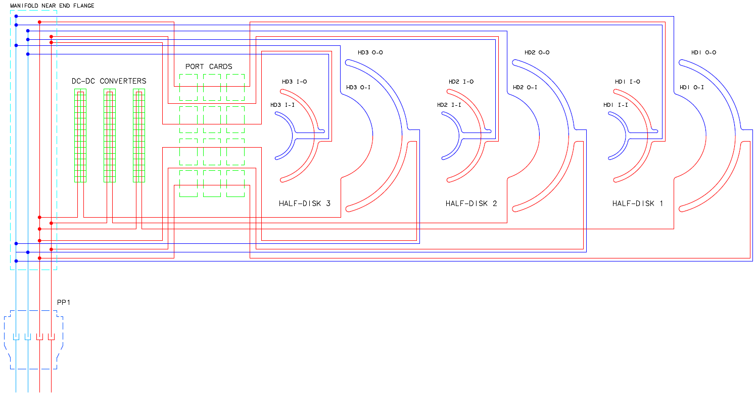
Cooling Loops for FPix Half-cylinder v3
1.8 mm ID tube
1.4 mm ID tube in this region
Heat Load and Tube Lengths for 9 Cooling Loops of an FPix Half-cylinder (typical for each of 4 half-cylinders)
FPIX Cooling Loop | Heat load from modules (t=0) [W]* | Heat load from DC-DC converters [W] | Heat load from port cards [W] | Heat load from cable losses [W] | Total heat load on cooling loop [W] | Length of cooling loop on half-ring OD 1.6 mm ID 1.4 mm [mm] | Lengths of radial legs of cooling loop OD= 1.6 mm ID= 1.4 mm [mm] | Lengths of longitudinal legs of loop near disk OD = 1.6 mm ID = 1.4 mm [mm] | Length of loop heated by port cards or DC-DC converters OD = 2.0 mm ID = 1.8 mm [mm] | Lengths of longitudinal legs of loop near manifold OD = 2.0 mm ID = 1.8 mm [mm] | Fluid mass flow for dP= 1.5 bar at -20 C [g/s] 130% heat load | Fluid exit quality [%] 130% heat load
HD1 O-O | 49.0 | 0 | 7.5 | 5 | 61.5 | 1052 | 0 | 340+350 | 300 | 1784+1774
HD1 O-I | 32.6 | 30 | 0 | 5 | 67.6 | 420 | 87+87 | 373+383 | 500 | 1784+1774
HD1 I-O & I-I | 52.8 | 0 | 7.5 | 5 | 65.3 | 962 | 137+78+59 | 342+352 | 300 | 1784+1774 | 3.56 | 8.5
HD2 O-O | 49 | 0 | 7.5 | 5 | 61.5 | 1052 | 0 | 296+306 | 300 | 1784+1774
HD2 O-I | 32.6 | 30 | 0 | 5 | 67.6 | 420 | 87+87 | 265+275 | 500 | 1784+1774
HD2 I-O & I-I | 52.8 | 0 | 7.5 | 5 | 65.3 | 962 | 137+78+59 | 265+275 | 300 | 1784+1774
HD3 O-O | 49 | 0 | 7.5 | 5 | 61.5 | 1052 | 0 | 168+178 | 300 | 1784+1774
HD3 O-I | 32.8 | 30 | 0 | 5 | 67.6 | 420 | 87+87 | 201+211 | 500 | 1784+1774 | 5.0 | 6.2
HD3 I-O & I-I | 52.8 | 0 | 7.5 | 5 | 65.3 | 1052 | 137+78+59 | 170+180 | 300 | 1784+1774
Totals | 403.2 | 90 | 45.0 | 45.0 | 583.2 |  |  |  |  |  | 38.5
4.2 m of copper tubing 10 mm ID
* Nominal heat load per module 2.4 W, Power apportioned between O-O and O-I rings at an estimated 6:4 ratio
19May2011

Slide 28
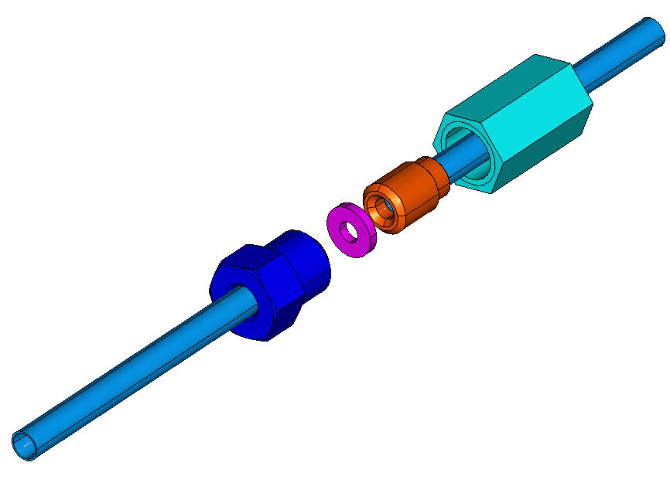
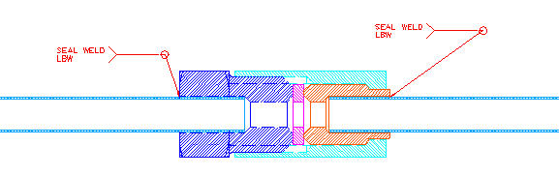
CO₂ Cooling Coupling Design
M3.5 female thread nut
gland
M3.5 male thread nut
Welded with tubing
Replaceable aluminum gasket
Welded with tubing

Slide 29
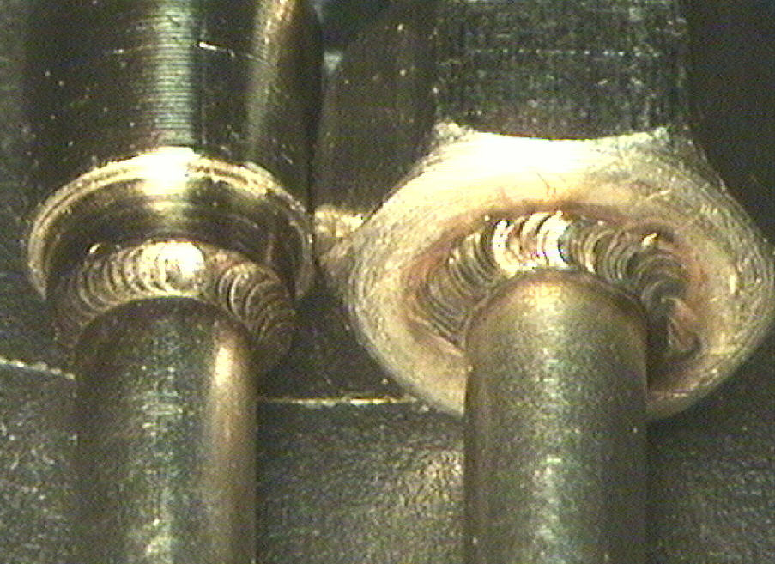
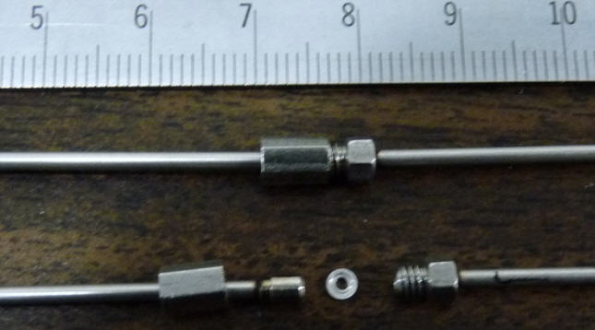
CO₂ Cooling Coupling Status
Weld for ferrule
Two sets of assemblies were laser-welded
Direct welding was done on gland
Welding rod 312 was used for male thread nut because of larger part tolerance (0.005” vs. 0.002”)
Vacuum leak check was made on both assemblies
No leak on aluminum washer sealing
No leak on gland weld
Leak on the male thread nut weld
Quick conclusion: Design and fabrication method OK, but needs tighter fitting tolerance
Weld for male threaded fitting

Slide 30
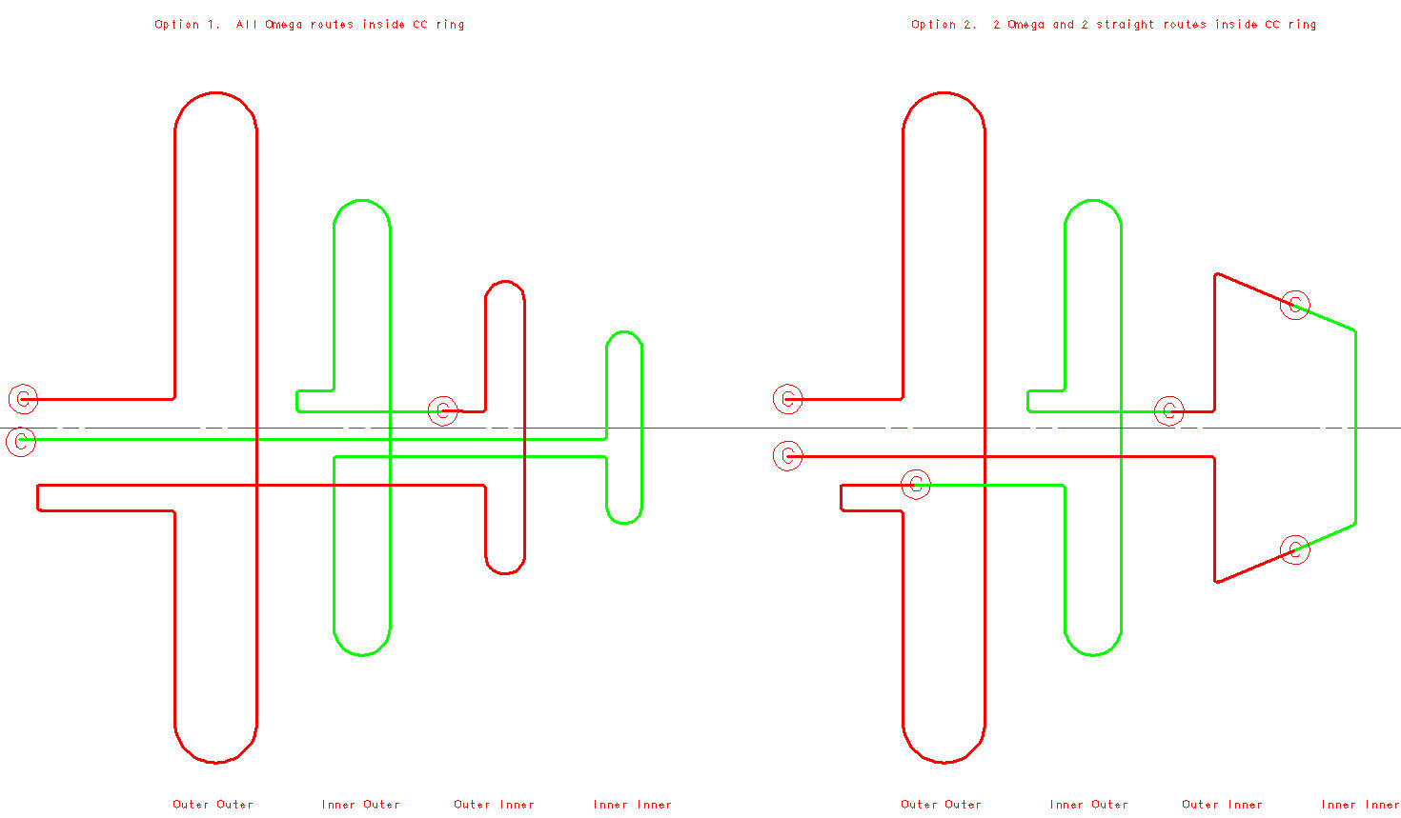
Couple of options for the revised cooling route within HC

